Slide 1
Memory Management Visualizer
Zhu Pengming 1195285
Xie Yalin 1195176

Slide 2
Outline
Introduction
Implementation of the allocation algorithm
The implementation of the visualization and the problems encountered

Slide 3
What we did
A memory management visualization tool built with JavaFX. The tool guides the user to input the number of partitions, partition size, process number and process information through the graphical interface, and then allocates memory according to the memory allocation algorithm selected by the user (First Fit, Next Fit, Best Fit, Worst Fit). At the same time, the memory allocation process is displayed through Gantt graphical charts

Slide 4
So how does it work
Once the user has selected a memory allocation algorithm, the algorithms select an appropriate Partition in the Partition[] array and assign it to the process entered by the user. Once the appropriate partition has been selected, the relevant partition information is recorded in PCB[]. A process control block is a data structure that stores and manages process information, including process name and size. We can then visualize the algorithm’s results by iterating over the partitioned array that stores and manages process information, including process name and size. We can then visualize the results of the algorithm by iterating over the partitioned array

Slide 5
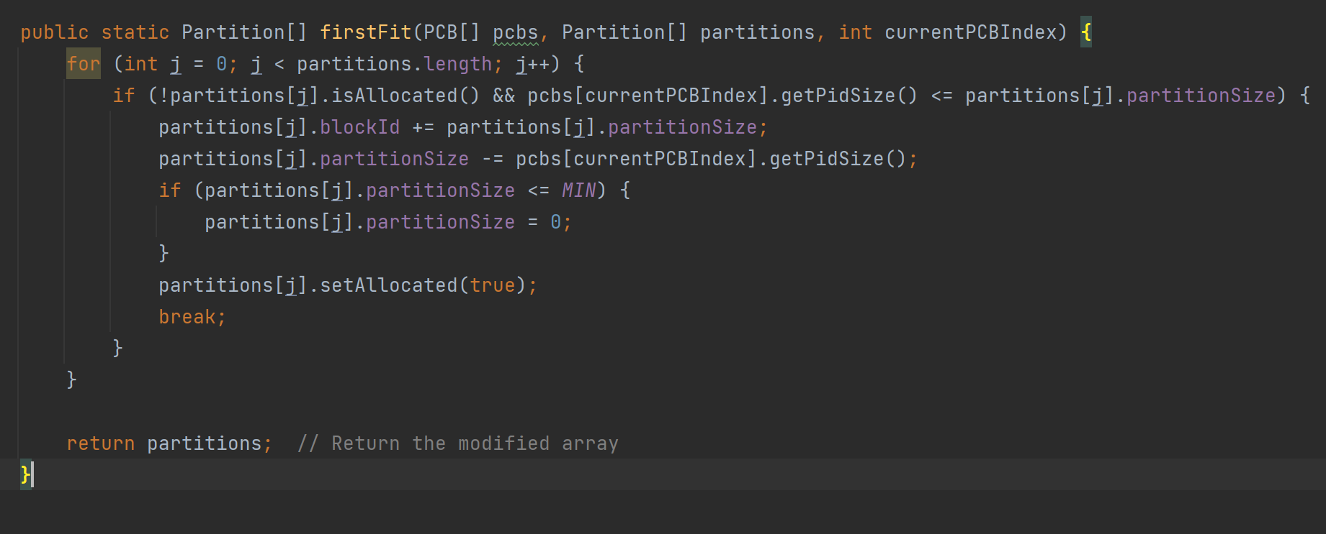
First fit algorithm
The first fit searches for suitable-sized partitions from scratch,
and the algorithm overhead is small.
Notes:
1.Traverse all memory partitions
2.Check that the partition is unallocated and large enough to accommodate the current process
3.Update the starting location and size of the partition
4.If the remaining partition size is less than or equal to the minimum threshold (MIN), set it to 0
5.Mark the partition as allocated

Slide 6
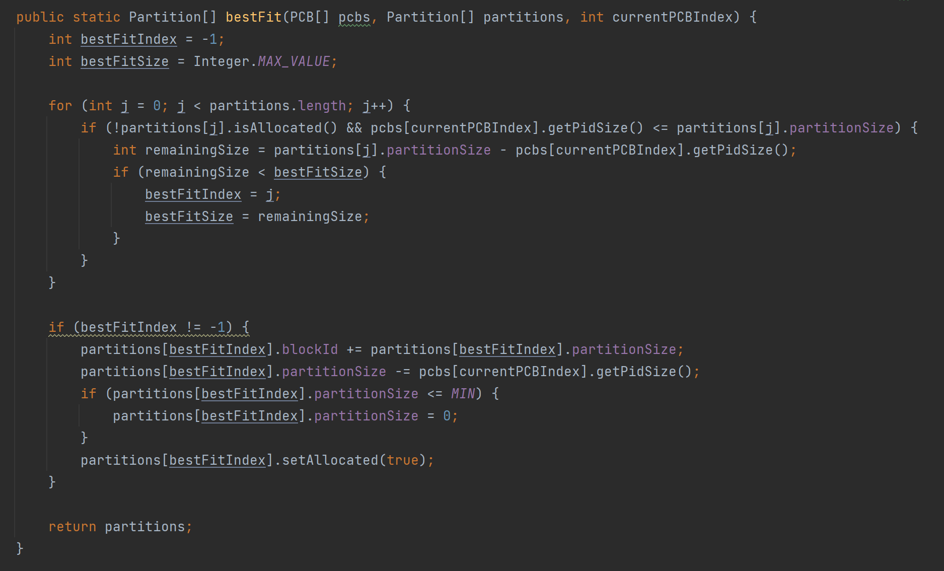
Best fit algorithm
The best fit selects the most suitable partition, but the sorting overhead is high.
Notes:
1. Initializes the best adapted index and size
2. Check that the partition is unallocated and large enough to accommodate the current process
3.If the remaining size of the partition is smaller than the current best fit, update the index and size of the best fit
4. If the best fit partition is found, if the remaining partition size is less than or equal to the set minimum threshold (MIN), set it to 0 and mark the partition as allocated

Slide 7
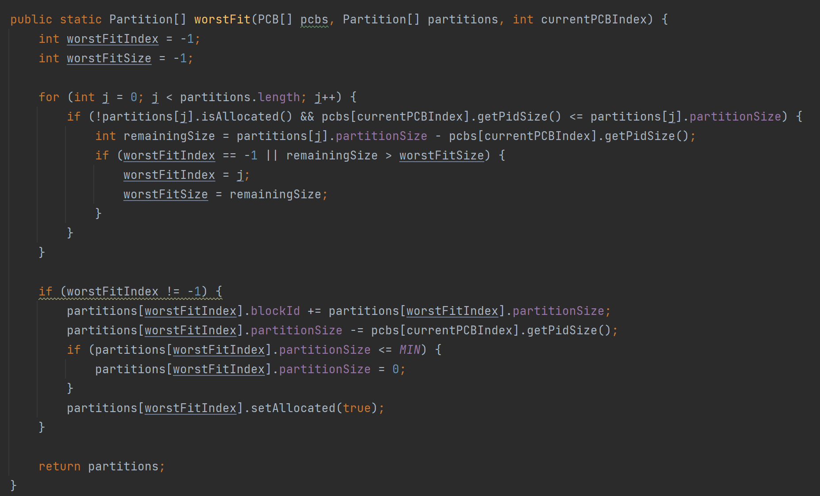
Worst fit algorithm
The worst fit selects the largest partition, reducing external fragmentation, but may lead to
starvation.
Notes:
Most of it is the same except when you compare the rest.
If the remaining size of the partition is larger than the current worst fit size, update the index and size of the worst fit

Slide 8
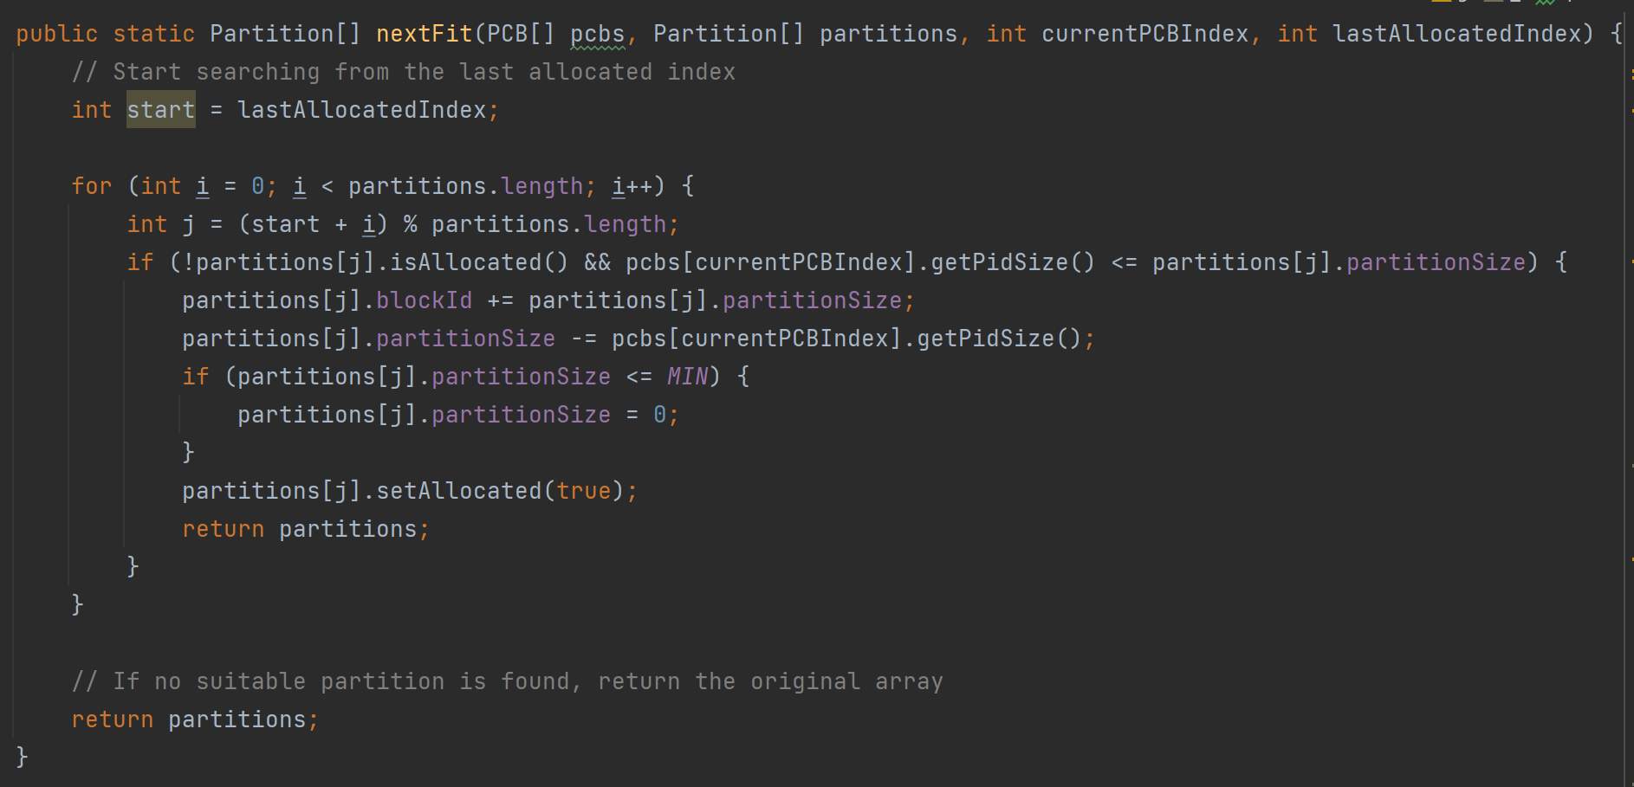
Next fit algorithm
Next fit is the first fit improve and reduce algorithm overhead.
Notes:
1.Search from the last assigned location
2.Uses a circular index to calculate the index of the partition you are currently checking
3. The others are the same as first fit

Slide 9
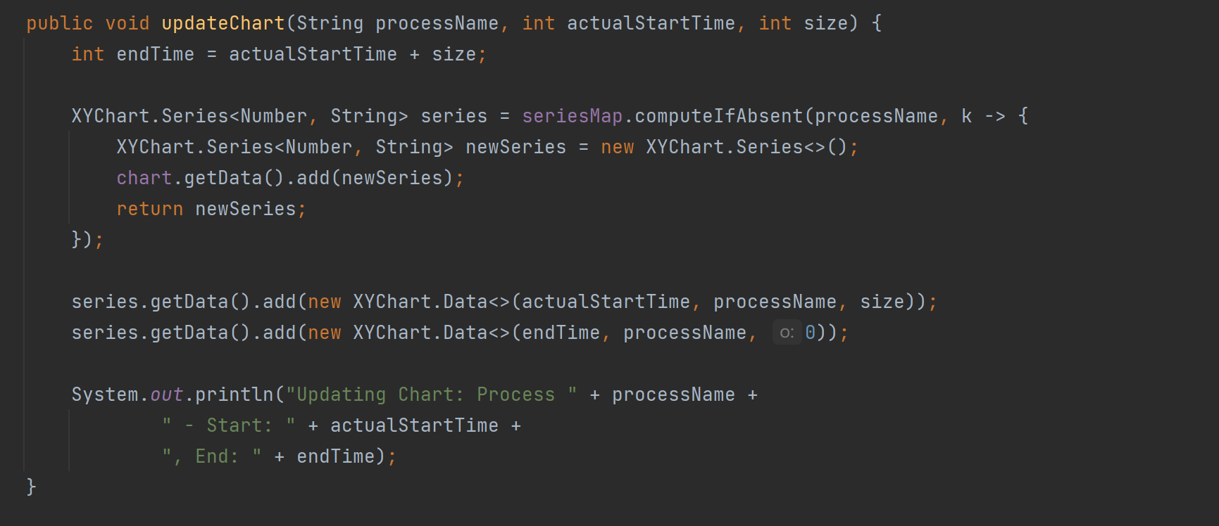
Visualization
Notes:
1.The end time of a process is calculated based on the actual start time and size of the process
2.The computeIfAbsent method is used to obtain the value if the Series of the process exists in seriesMap. If it does not exist, a new Series object is created and added to the diagram.
3.Add two data points to the Series, indicating the start and end times of the process. The X coordinate of the data point is the time, and the Y coordinate is the process name
4.Print updated information to the console, including process name, start time, and end time.

Slide 10
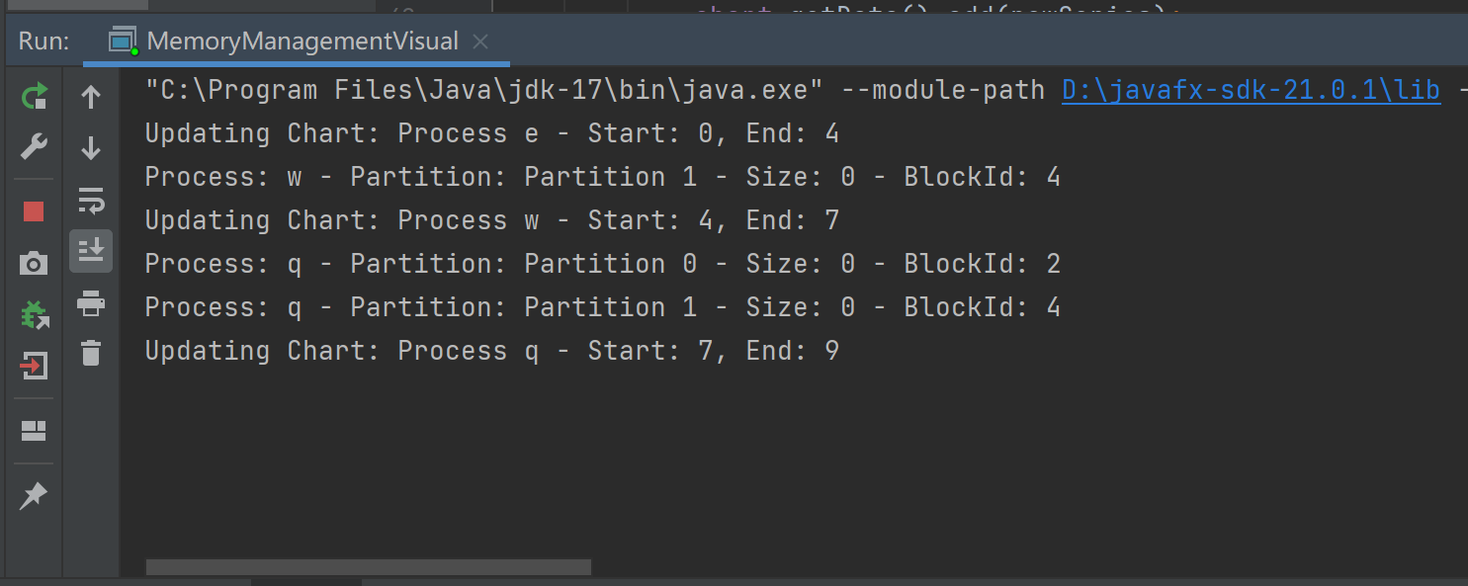
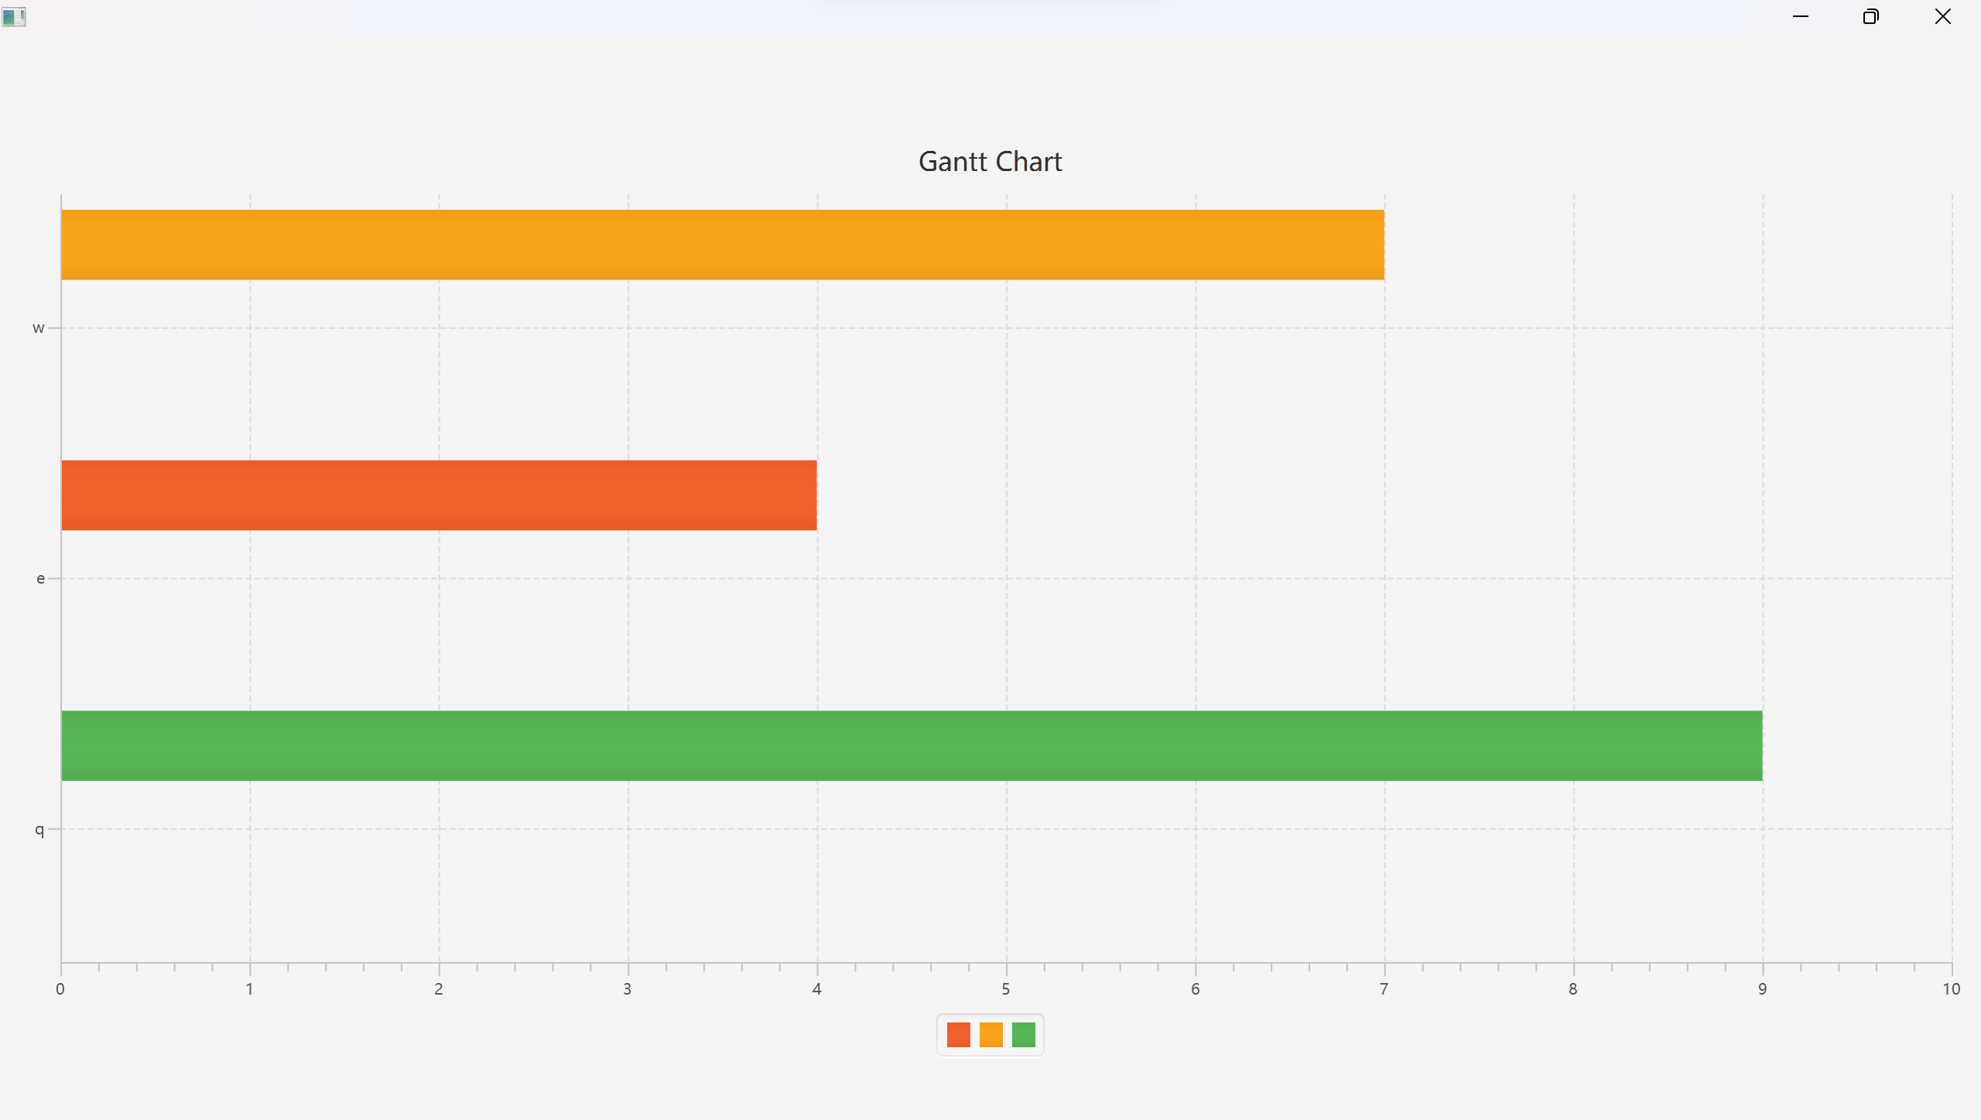
Difficulty
Notes:
This is the result of our output. Here we encountered a difficulty. The data printed by the console is correct but all processes on the Gantt chart start at 0 and their end times are correct.

Slide 11

Notes:
This is our GitHub project website

Slide 12
Thank you

